Slide 1

Customer Segmentation and Price Optimization Strategies for Singi's kitchen
Sharad Anirudh Jonnalagadda
23F2000690@ds.study.iitm.ac.in

Slide 2
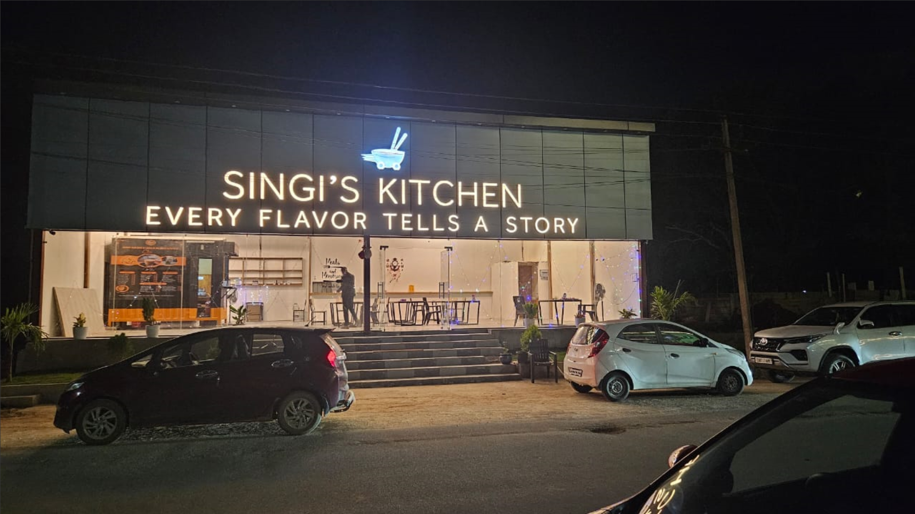
Project Overview
Singi’s Kitchen is a community restaurant, which opened its doors in September of 2024. It serves a community of 269 villas, having both takeaway as well as dine-in options available. Restaurant serves both Veg and Non-veg dishes.
The restaurant faces multiple challenges which include:
Unidentified Customer base
Lack of knowledge over well-performing dishes
Inefficient Inventory Management
Lack of an optimized Menu
To address this, a 4-stage analytical framework was designed and implemented, They broadly are:
Developing Potential score & Grid-heat maps: Constructing a mathematical model which describes customer loyalty, color-coding this onto a satellite image of community to construct heat maps.
Menu Analysis & Optimization: Constructing a Menu score to analyse performance of items and categorizing them based on their Menu score.
Inventory Management: Based on stock usage, stock wastage, and reorder patterns to improve overall procurement efficiency.
Finalized Menu Design: Use economic principles and menu engineering concepts to create a profitable and sustainable Menu.

Slide 3



Data Collection & Preprocessing
Potential Score Dataset
Data was collected from 269 villas in a period of 1 month.
Features included order frequency, ratings, background, preferences & Potential score.
Most of data collection was done via physical register, rest was found by surveying.
Lot of preprocessing work was done which included, standardizing villa numbers, normalizing phase scores, populating missing entries and etc.
Time duration:
3rd October – 2nd November
Menu score Dataset
Sales data of 41 dishes were collected in a period of 1 month
Features included: Orders per month, Selling price, Cost to prepare, profit margin, Revenue, Profit, Phase score & Menu score.
Data collection done using register.
Preprocessing work included, excluding seasonal dishes, excluding side dishes, items not made in- house and etc.
Time duration:
7th October – 7th November
Inventory Management Dataset
Data was collected of 28 ingredients over a period of 1 month.
Key Features included: Daily usage, stock ordered, reorder level, spoilage loss & waste.
Data collection done using register.
Preprocessing work included, unit standardization, aligning stock cycles, handling missing values etc.
Time duration:
21st October – 23rd November

Slide 4
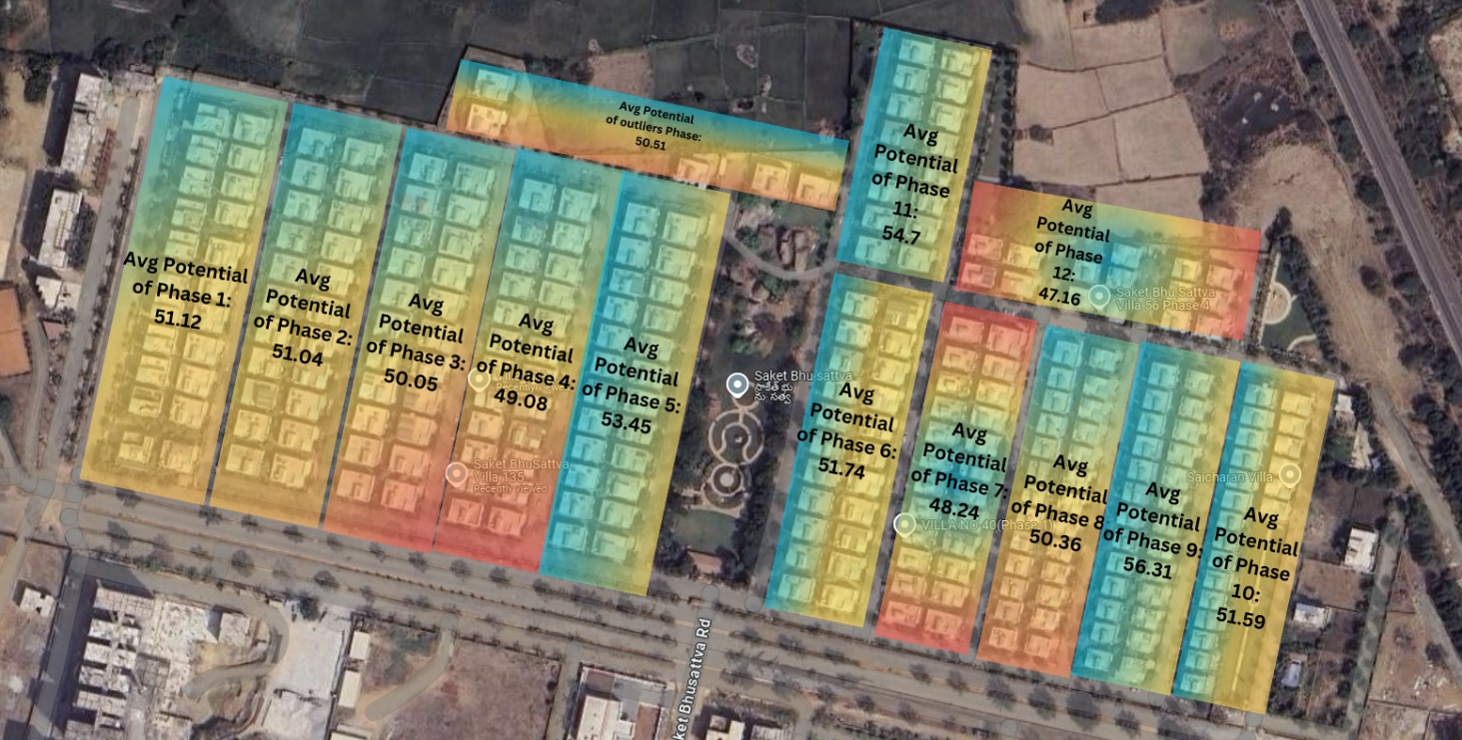
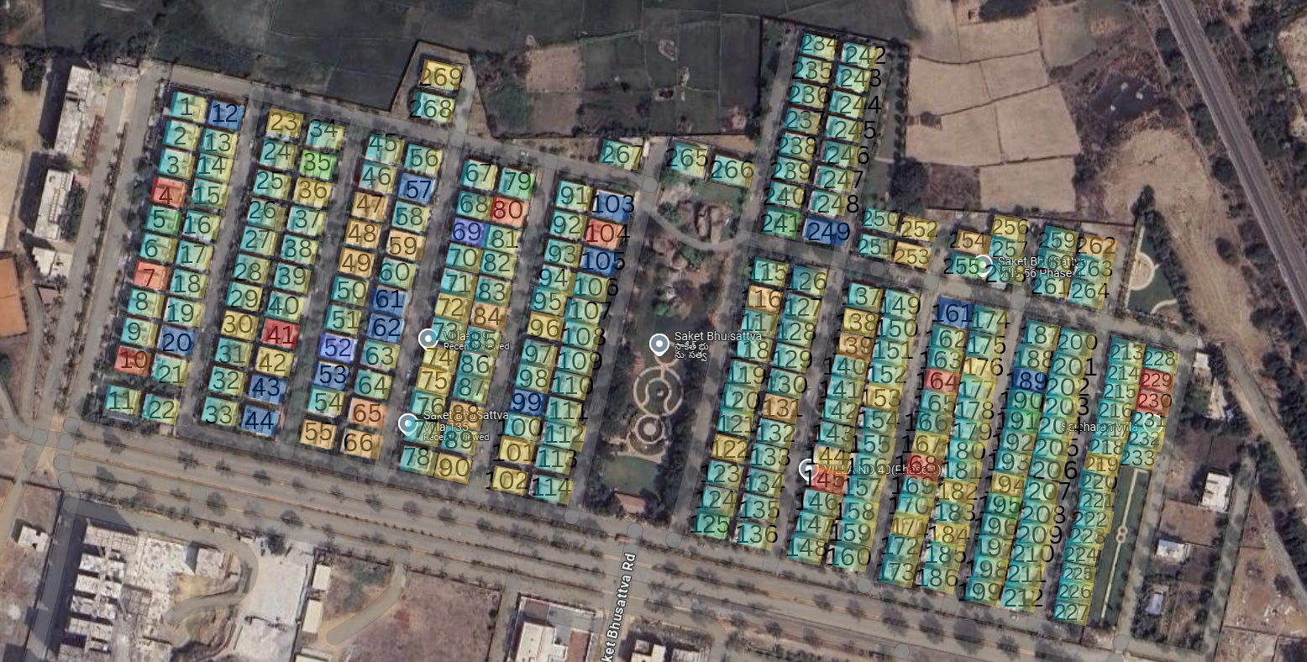
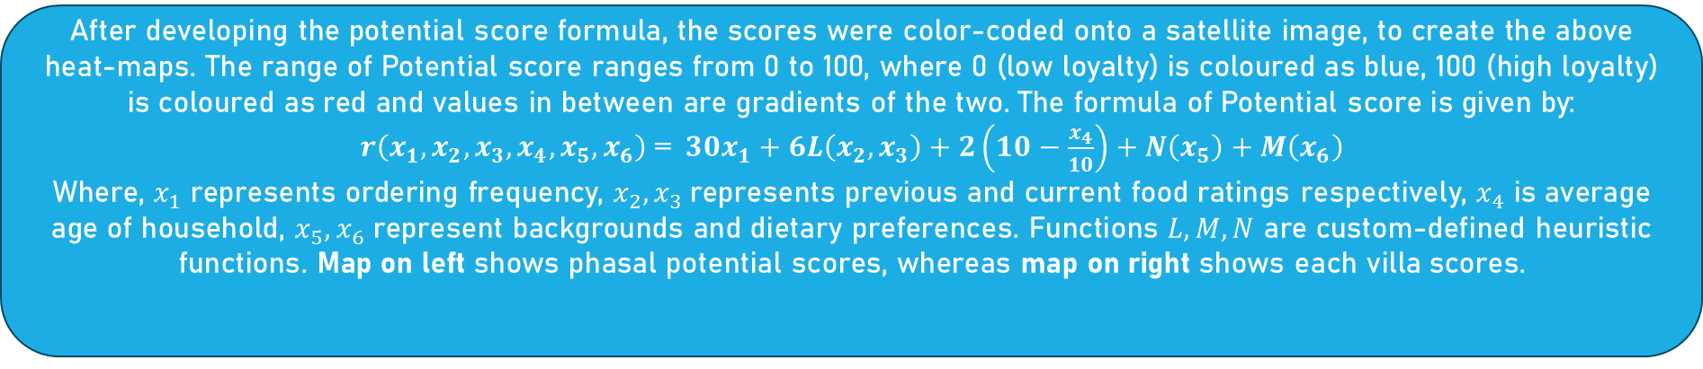
Customer Segmentation using Heatmaps
After developing the potential score formula, the scores were color-coded onto a satellite image, to create the above heat-maps. The range of Potential score ranges from 0 to 100, where 0 (low loyalty) is coloured as blue, 100 (high loyalty) is coloured as red and values in between are gradients of the two. The formula of Potential score is given by:
$r\left(x_{1},x_{2},x_{3},x_{4},x_{5},x_{6}\right)$ =$30x_{1}+6L\left(x_{2},x_{3}\right)+2\left(10−\frac{x_{4}}{10}\right)+N\left(x_{5}\right)+M\left(x_{6}\right)$
Where, $x_{1}$ represents ordering frequency, $x_{2},x_{3}$represents previous and current food ratings respectively, $x_{4}$ is average age of household, $x_{5},x_{6}$ represent backgrounds and dietary preferences. Functions $L,M,N$ are custom-defined heuristic functions. Map on left shows phasal potential scores, whereas map on right shows each villa scores.

Slide 5
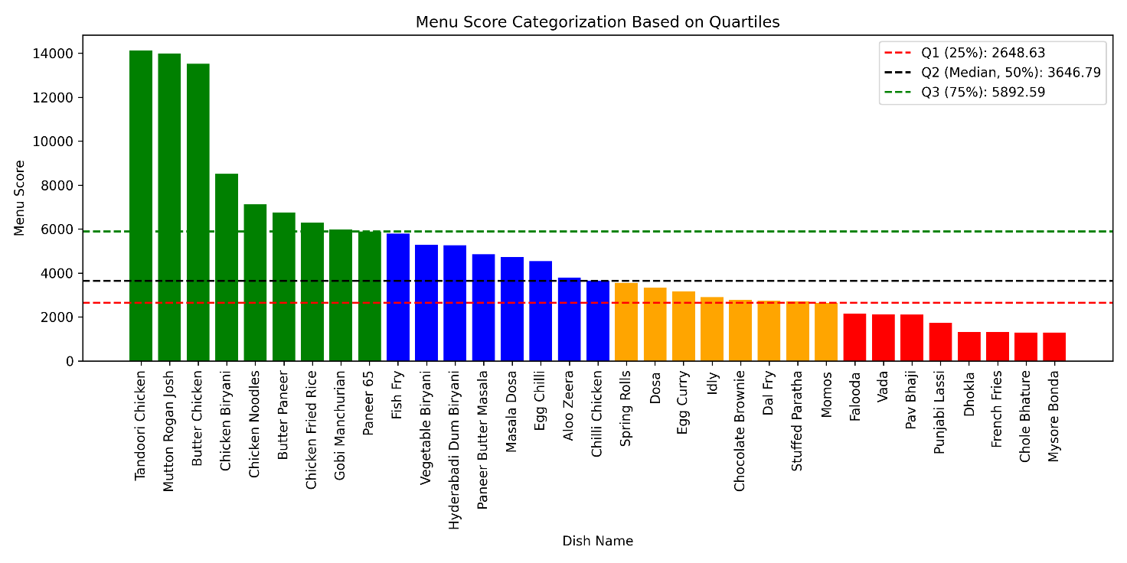
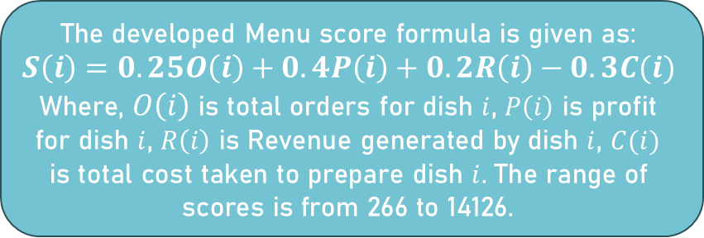
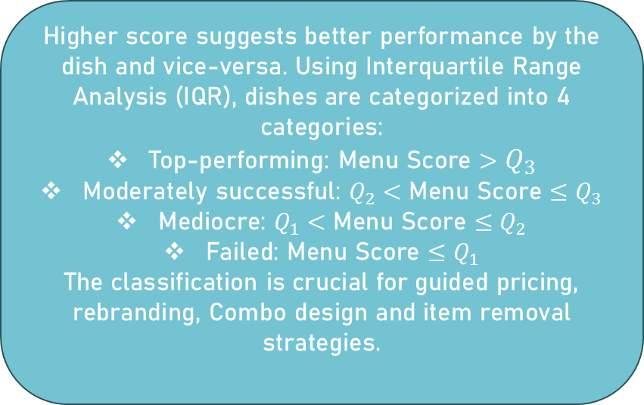
Menu score Analysis & Dish Categorization
The developed Menu score formula is given as:
$$S\left(i\right)=0.25O\left(i\right)+0.4P\left(i\right)+0.2R\left(i\right)−0.3C(i)$$
Where, $O\left(i\right)$ is total orders for dish $i$, $P\left(i\right)$ is profit for dish $i$, $R\left(i\right)$ is Revenue generated by dish $i$, $C(i)$
is total cost taken to prepare dish $i$. The range of scores is from 266 to 14126.
Higher score suggests better performance by the dish and vice-versa. Using Interquartile Range Analysis (IQR), dishes are categorized into 4 categories:
Top-performing: Menu Score $>$ $Q_{3}$
Moderately successful: $Q_{2}$ $<$ Menu Score $≤$ $Q_{3}$
Mediocre: $Q_{1}$ $<$ Menu Score $≤$ $Q_{2}$
Failed: Menu Score $≤$ $Q_{1}$
The classification is crucial for guided pricing, rebranding, Combo design and item removal strategies.
🔴 Failed Items Category
🟡 Mediocre Items Category
🔵 Moderately Successful Items Category
🟢 Top-performing Items Category

Slide 6




Pricing Strategy Implementation
Implementing a multi-dimensional pricing strategy using PED analysis, menu engineering and consumer psychology principles. Items were analysed based on their elasticity, items with higher elasticity received a 5-10% price hike, whereas items with lower elasticity were either bundled with successful items or received 5-15% price drop. In addition, charm, decoy, bundling strategies as well strategies to remove failed items with no possible interventions were also implemented.
Top-performing items price changes:
Tandoori chicken: 300 ₹ → 310 ₹
Mutton Rogan Josh: 400 ₹ → 420₹
Butter chicken: 280 ₹ → 290 ₹
Chicken Biryani: 250 ₹ → 260 ₹
Paneer 65: 160 ₹ → 180 ₹
Moderately successful items category:
Fish fry: 350 ₹ → 330 ₹
Vegetable Biryani: 180 ₹ → 160 ₹
Hyderabadi Biryani: 300 ₹ → 280 ₹
Paneer Butter Masala: 220 ₹ → 200 ₹
Chilli Chicken: 200 ₹ → 180 ₹
Mediocre Items Category:
Dosa, Idly were priced at 80 ₹ & 50 ₹ → Breakfast delight priced at 200 ₹: 1 Masala dosa + 1 Idly + 1 Lassi
Idly, vada were priced at 50 ₹ each → Economic combo delight at 120 ₹: 2 Idly + 1 vada
Failed Items Category:
French fries (90 ₹) is now repositioned as Masala French fries at 120 ₹
Momos (110 ₹) is now repositioned as Tandoori Momos at 100 ₹
Items like Dhokla, Pav Bhaji, Chole Bhature are removed

Slide 7
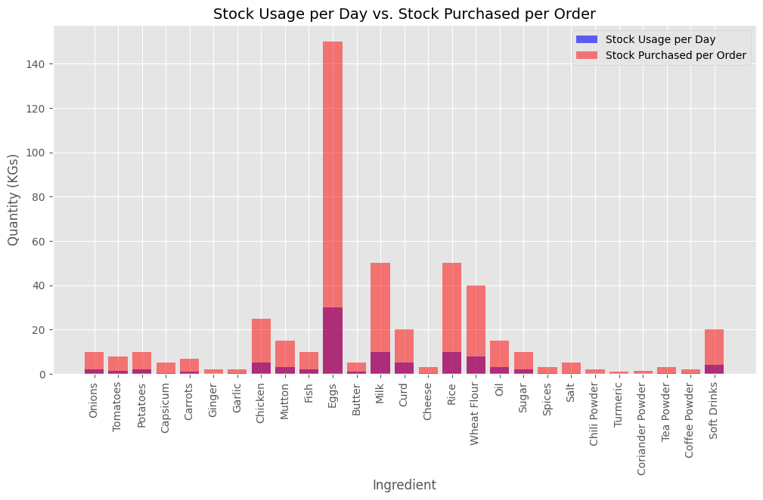
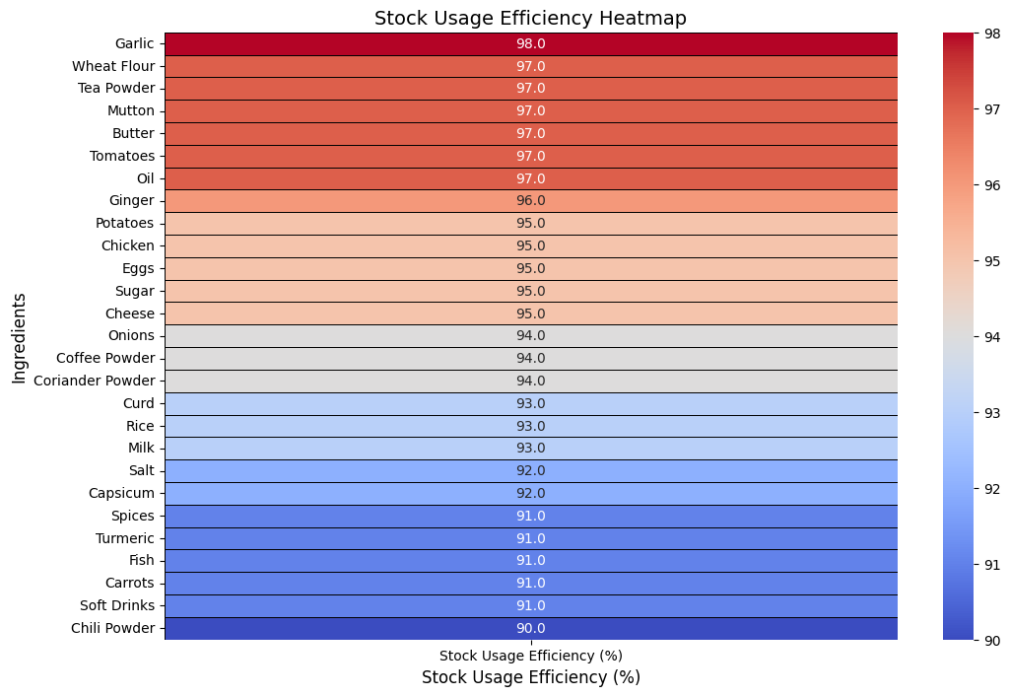
Inventory Optimization & Analysis
Inventory Optimization was performed based on economic principles and various business analytics principles. Analysis was performed over 28 ingredients over 14 different features. Based on the optimization, some of the important results are:
High stockage efficiency in essential ingredients, for instance, wheat flour, tea powder and Mutton exhibit highest stock usage efficiency (~97-98%).
Eggs, butter and rice have very higher order quantity (KGs) and comparatively very low usage rate. This implies high stock pillage loss and an overall higher waste percentage in these goods.
Items related to spices and seasonings have a very low stock usage efficiency (~90-92%), meaning excess stock is maintained and demand is not aligning with the expected demand.
Higher perishable items are showing lower stock usage efficiency whereas lower perishable items are showing higher stock usage efficiency, which suggests a lack of proper inventory management system.

Slide 8

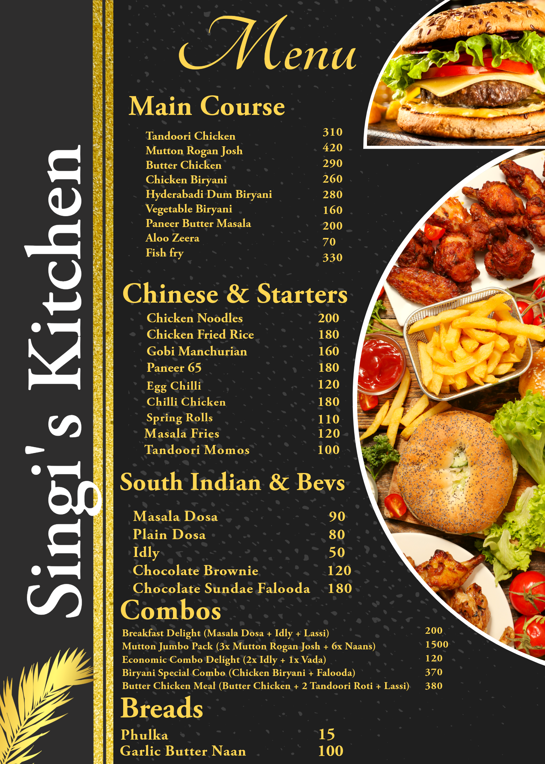

Finalized Optimized Menu
Number of total items are reduced from 41 to 28
Top-performing dishes are retained, prices are slightly increased
More Non-Veg dishes in Menu based on sales data analysis
Moderately successful dishes are retained, prices decreased slightly
Mediocre items are bundled into combos majorly, few received price tweaks.
Failed items are mostly removed and the remaining ones are bundled as combos.

Slide 9



Interpretation & Key findings
Customer Segmentation Insights:
Heatmap segmentation Identified high & low-potential zones within the 269-villa community
Targeting high potential zones will lead to higher customer loyalty & higher revenues
Inventory efficient gains:
Analysis across 28 ingredients revealed overstocking in perishables & inefficiency in spices
Optimized reorder levels, purchase frequencies, and waste reduction improve overall stock usage efficiency
Pricing strategy impact:
Top-performing items received 5-10 % price hike, Moderate ones received 5-15 % price fall, Mediocre ones were mostly bundled into combos & Failed items were mostly removed
Applying charm strategy & decoy strategy led to better value perception & sales balance
Menu performance insights:
Menu score successfully categorized 41 dishes into 4 performance tiers
Top performing items include: Tandoori Chicken, Butter Chicken. Moderate items include: Fish fry, Egg chilli. Mediocre items include: Dosa, Idly. Failed items include: Pav Bhaji, Dhokla
Finalized Menu optimization insights:
Final menu reduced from 41 to 28 operational dishes while preserving diversity & customer demand
Finalized menu is inclined more towards non-veg dishes based on the sales data analysis & customer surveys

Slide 10
Strategic Recommendations
Customer Targeting:
Focus marketing efforts on Phase-5, Phase-9 & Phase-11, which have shown highest customer potential
Introduce Phase specific discounts or loyalty programs to maximize returns from high potential zones
Menu strategy:
Increase prices by 5-10% for top performers (e.g., Tandoori chicken, chilli chicken)
Bundle mediocre dishes into value combos (e.g., Economic combo delight)
Implement 80-20 rule, that is, retain 80% of the existing menu while seasonally rotating rest 20% of the menu, keeping the offerings fresh
Inventory Management:
Reduce purchase frequency & order quantities of high-waste perishables like eggs & butter
Lower the procurement involving spices & beverages to reduce stock usage efficiency
Implement a threshold based stocking system (5-8%) to increase overall inventory efficiency
Business & Marketing strategies:
Maintain a digital register for tracking all sales & inventory related data
Conduct customer surveys annually to gather feedback & preferences to finetune the menu
Create brochures, pamphlets & posters to advertise the newly introduced value combos

